Slide 1
Design Patterns in Object Oriented Programming
Catherine Sheen
Notes:
Design Patterns in Object oriented programming

Slide 2
Contents
Introduction to Design Patterns
Potential Patterns, Justified and Implemented
Critical Evaluation
Notes:
In this presentation we will first consider what design patterns are, then we will consider designs we could implement in our own code and how they have been implemented. Finally we will critically evaluate the solution.

Slide 3
What are Design Patterns
Reusable
Language-agnostic
Provide a shared vocabulary
Proven
Notes:
So what are design patterns?
Object-oriented design patterns are reusable solutions to common coding conundrums that arise during software design and development. They provide a set of proven techniques and best practices for designing oo systems.
Design patterns are language-agnostic concepts and can be applied to any OOP language. They also provide a shared vocabulary with other developers which allows easier communication with colleagues and helps developers to think at pattern level without getting bogged down by details. They allow develops to easily communicate ideas as communicating in patterns allows for a understanding of the constraints and characteristics of the pattern and not just its structure.
Each pattern addresses a specific problem and provides a reusable solution. Design patterns help improve code flexibility, reusability, and maintainability by promoting modular and decoupled designs.
Design patterns are split between class and object patterns. Class patterns focus on relationships via inheritance between classes, whilst object patterns are usually defined by composition and the relationship between objects. Object patterns are usually more flexible and dynamic than class patterns as they are typically created at runtime rather than compilation.

Slide 4
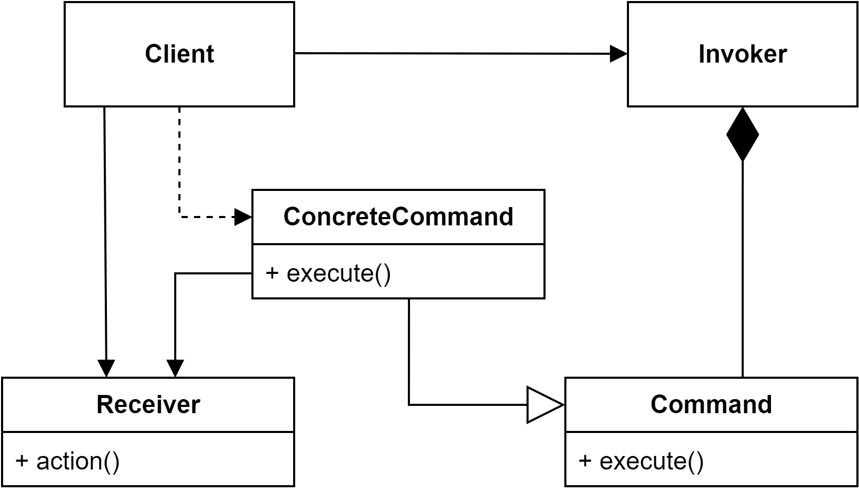
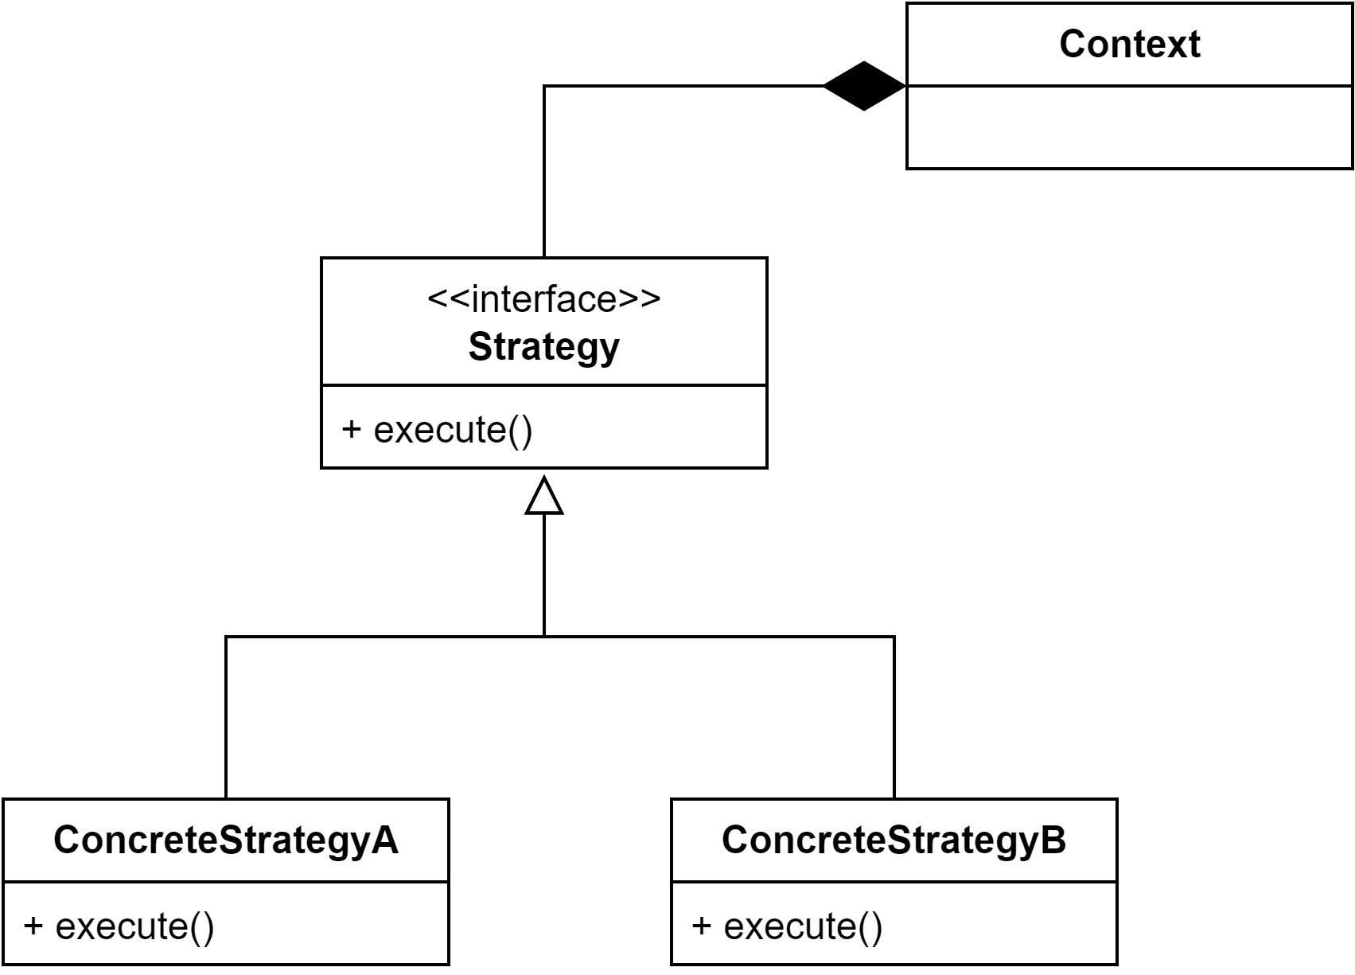
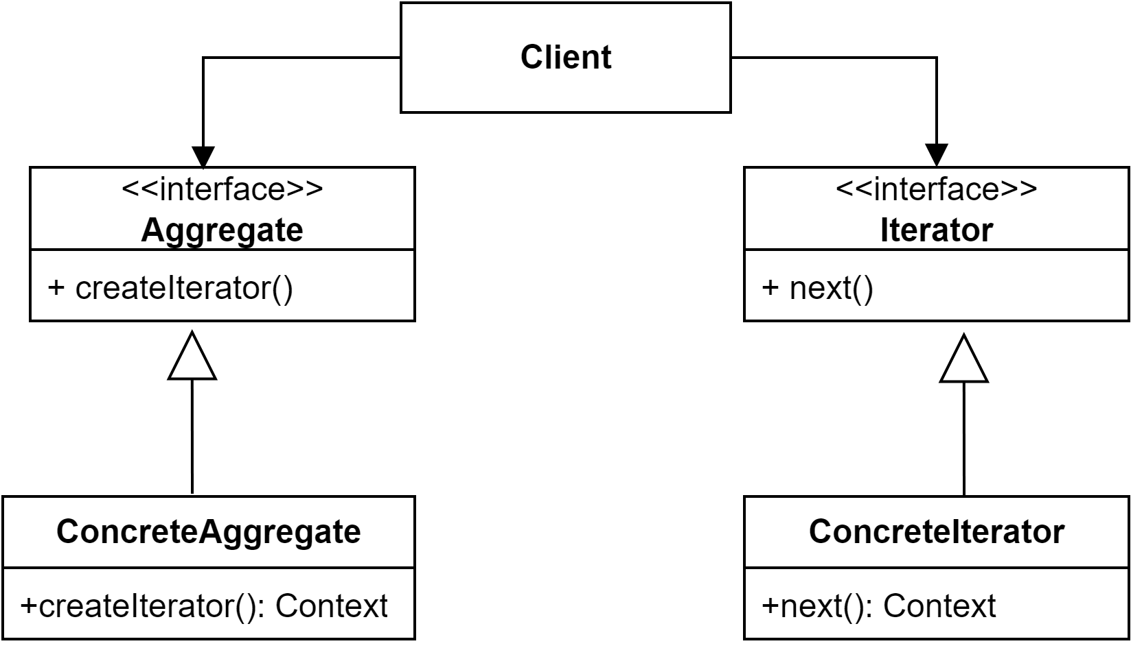
Behavioural Patterns
Command
Strategy
Iterator
Notes:
Behavioural patterns address the communication between objects and how they distribute responsibility. These patterns identify communication patterns between objects and classes and provide a solution for commonly occurring object and class interactions.
The three behavioral patterns presented here are focused on encapsulating behaviour in a object and delegating requests to it.

Slide 5
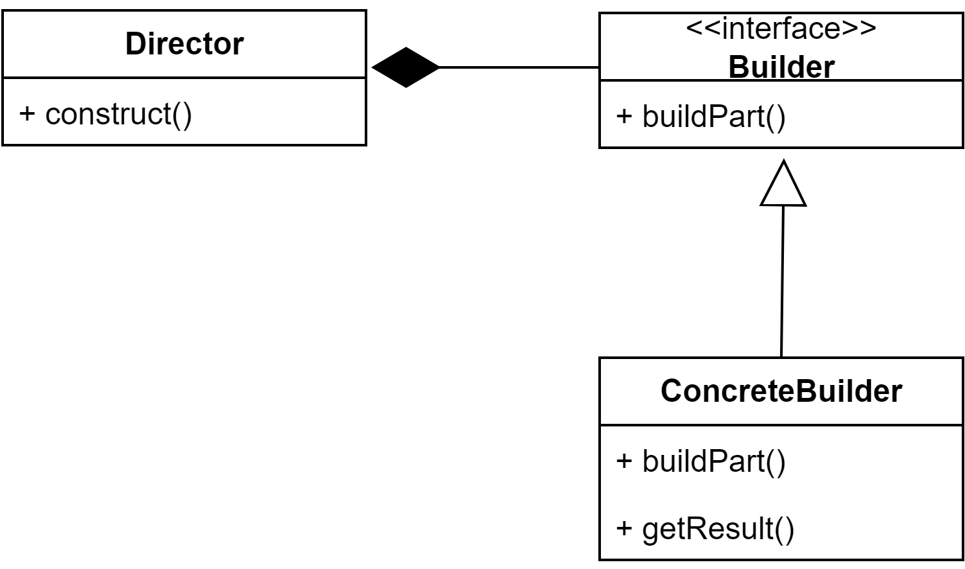
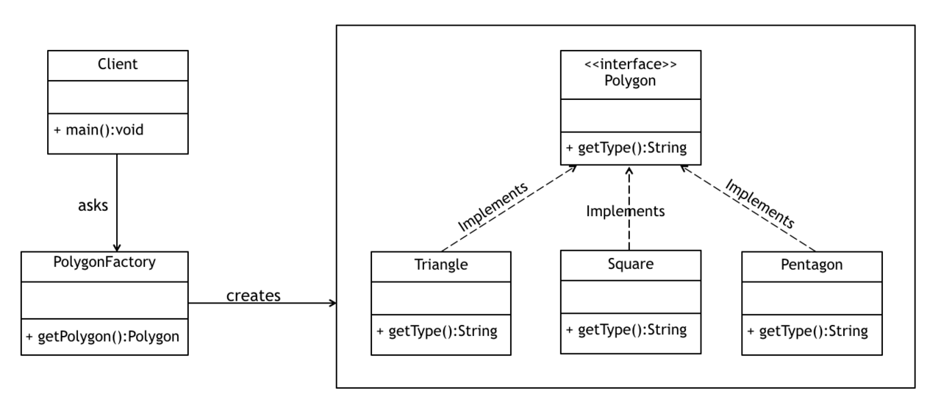
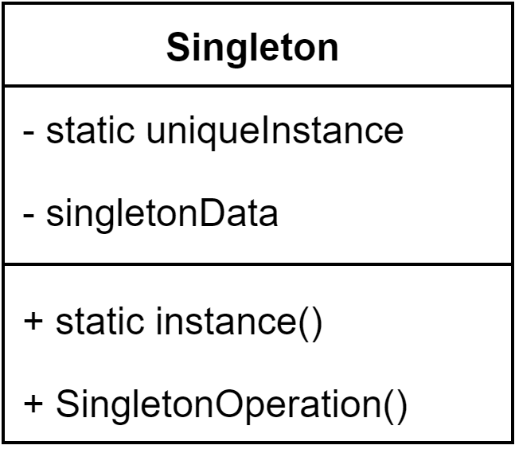
Creational Patterns
Builder
Singleton
Factory
Notes:
Creational patterns focus on how objects are created and instantiated. They provide us with ways to create objects in a flexible and efficient manner by decoupling clients and objects, thus creating systems independent of their object creation and representation. Creational patterns allow us to move away from hard-coding behaviors.
One of the benefits of patterns is their ability to be combined or used as alternatives to each other. Patterns can be combined with patterns in the same category, such as the builder pattern being used to build a complex object which will be initialized as a singleton so only a single instance is created. They can also be combined across categories such as using a behavioral Command pattern to encapsulate information to run our usecases within a factory method.

Slide 6
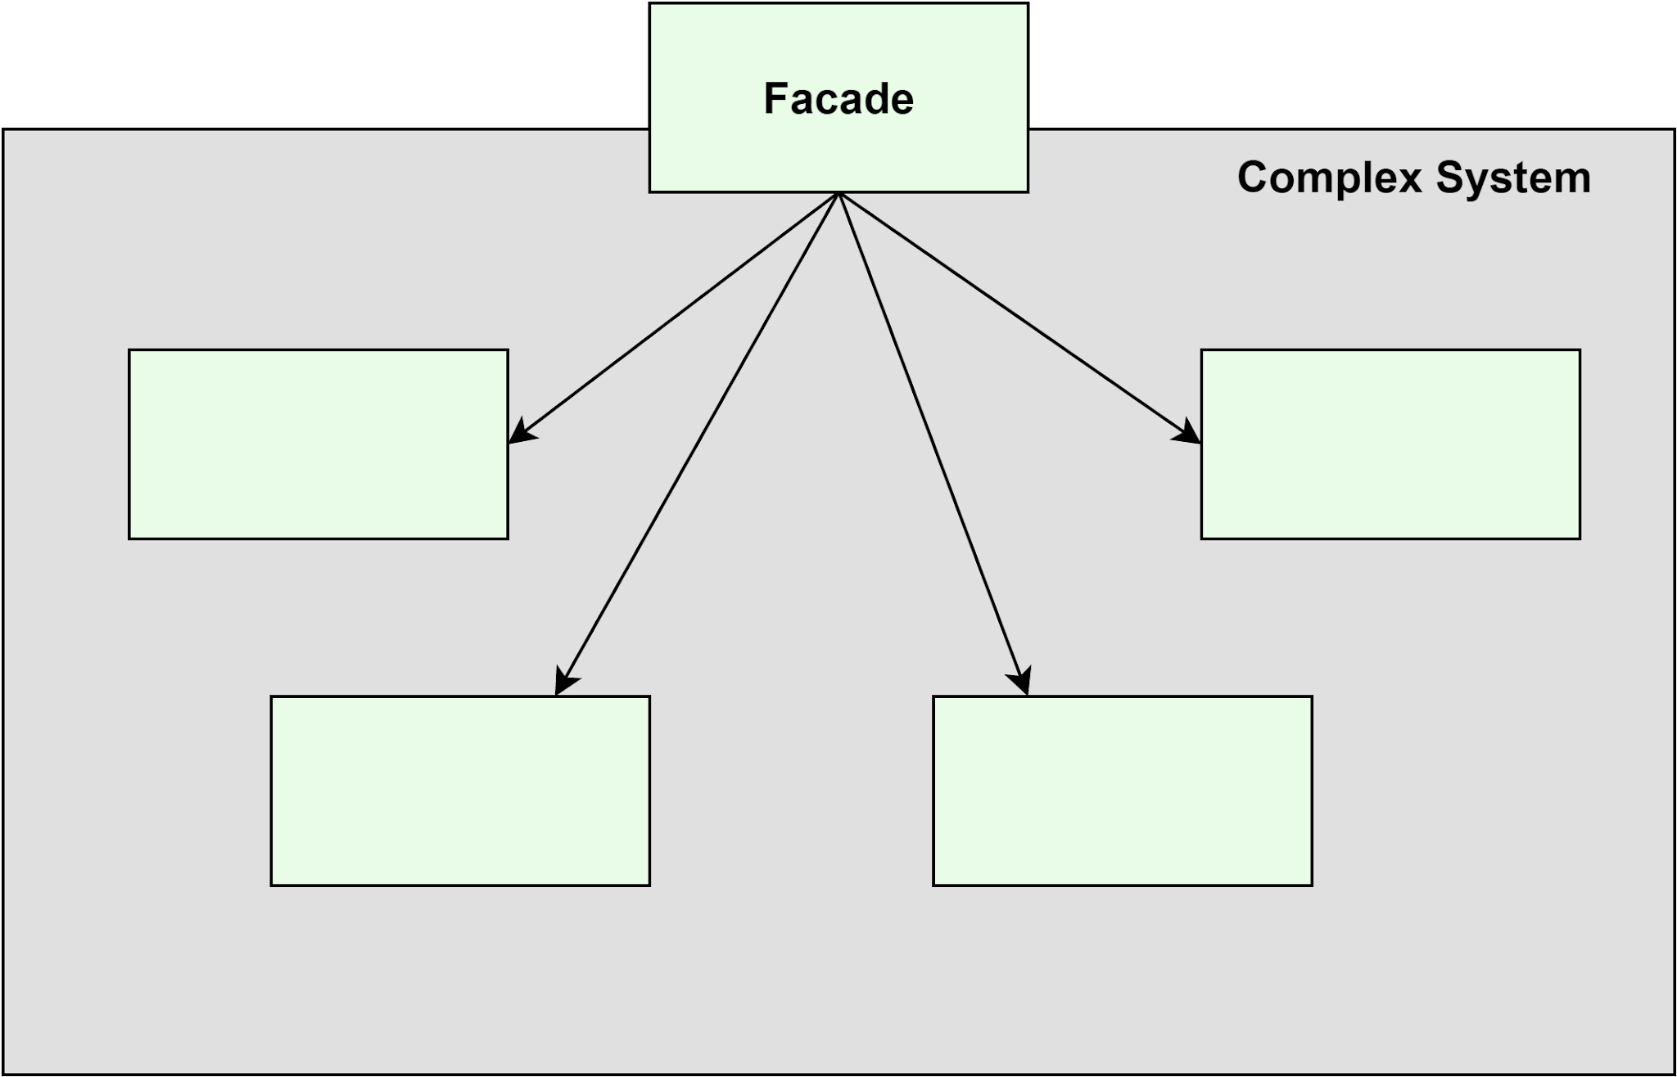
Structural Patterns
McDonald, J. S., (2007) http://www.mcdonaldland.info/
Notes:
Finally, we have structural patterns. These patterns are concerned with class and object composition into larger structures. They commonly use inheritance to create interfaces or implementations and describe ways to compose objects to access expanded functionality.

Slide 7
Strengths of Design Patterns
Reusability
Maintainability
Flexibility
Collaboration
Notes:
Design patterns have multiple strengths.
They are reusable: Design patterns provide reusable solutions, saving time and effort by not having to reinvent the wheel.
They create maintainable code: by promoting well-structured code, which is easier to understand, modify and maintain over time.
Provide flexibility: Patterns allow us to design flexible and extensible systems, which can adapt to changing requirements more easily.
Improving collaboration: Design pattzerns provide a common language and a set of concepts, enabling effective communication and collaboration among developers.

Slide 8
Limitations
Learning Curve
Pattern Happy (Kerievsky, J., 2004)
Context Dependency
Notes:
However they also have limitations
There is a learning curve: Some patterns may have a steep learning curve, particularly for beginners. It takes practice and experience to identify where to apply them and to do so effectively.
Becoming pattern happy: Sometimes design patterns can be overused and added to code for the sake of it. One of the biggest learning curves is learning to recognise when to apply them and when to keep code simple.
Context dependency: Not all patterns are suitable for all code and situations.

Slide 9
Potential Patterns, Justified and Implemented
Notes:
So next we will look at potential patterns, how they benefit our code, and how we implemented them.

Slide 10
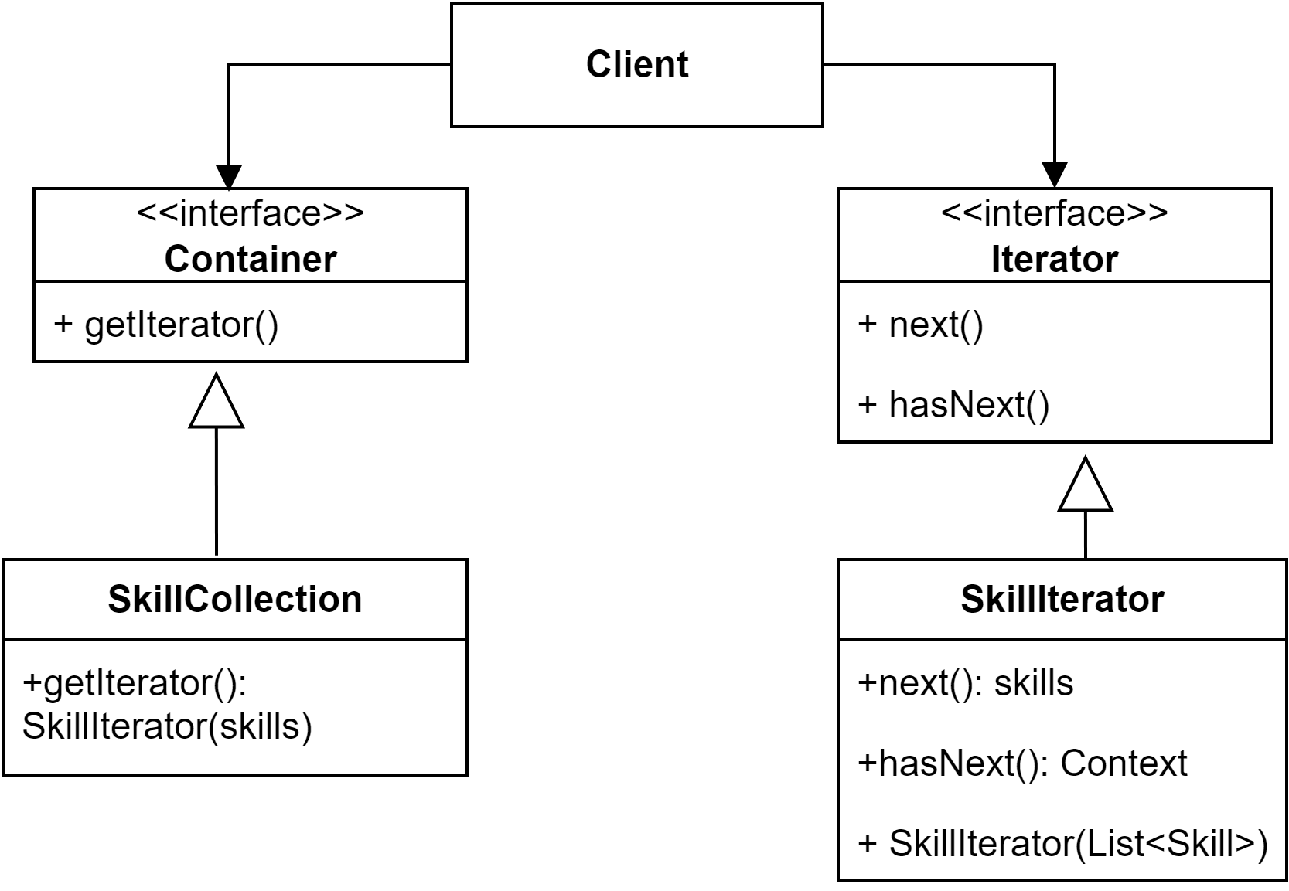
Iterator
Iterator interface provides a interface that all iterators must implement which includes methods for traversing over the collection
The Container interface decouples the client from the implementation of the aggregate
The Concreate iterator has responsibility of managing the current iteration position
The concreate collection contains the collection of objects and implements the methods that return the iterator
Notes:
The iterator pattern provides a way to access elements of a collection without exposing its internal structure.
It provides a easier way to traverse collections, mitigating issues that are present with list issues //Such as being required to write operations for different traversals.//
The iterator pattern takes responsibility for accessing and traversing the collection by putting it into a iterator object which is responsible for knowing the current state of its traversal and can support multiple traversals.
It also provides a uniform interface for traversing different collection structures.
This pattern allows for the collections within my code to be encapsulated by providing a iterator interface which could be used for multiple types of object collections such as staffUser, userSkill, manager and category models.

Slide 12
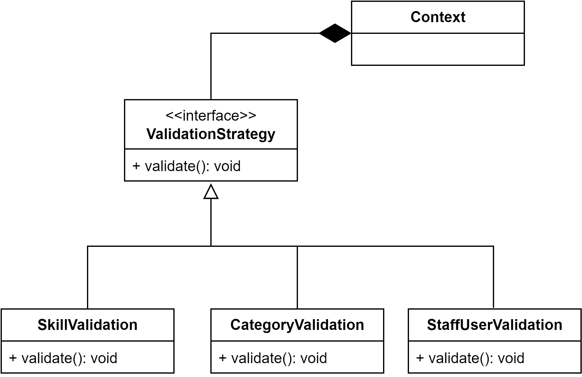
Strategy
Context refers to our domain classes
Encapsulated Validation Behaviour
Interface which includes the validate method to implement
The ValidateStrategy interface can be reused across multiple classes without requiring inheritance
Implementation of validate. Additional validate behaviours can be added without modify the validation interface and by removing the existing validate() from included domains
Notes:
The Next design pattern to consider is the strategy pattern.
The strategy pattern benefits the code due to introducing the benefit of reuse to our validator without it being dependent on inheritance and therefore allows us to use the validator across a wider range of objects. It also allows us to change behaviour more flexibly, as rather then hardcoding our validation within our code, we instead validate our skills as we create a new skill object.
First a interface is created which contains the method that needs to be implemented.
Concrete classes are then created which contain the implementation of the interface.
This provides the code flexibility as additional concreate classes with new implementations of behaviour could be added, without requiring changing the existing code.

Slide 14
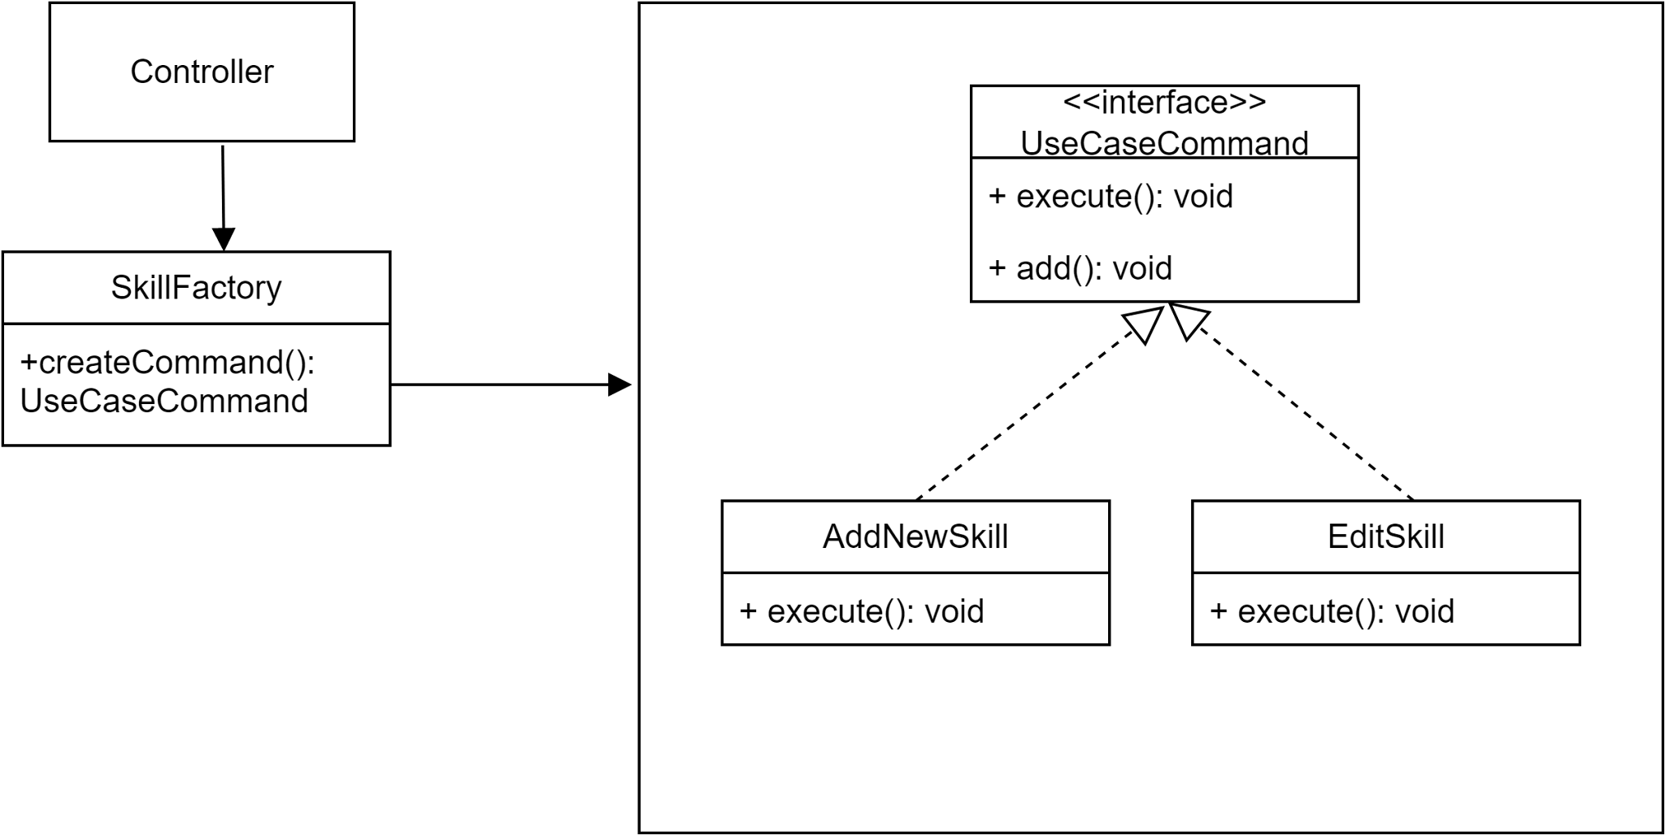
Factory + Command
UseCaseCommand provides a common interface to execute our useCases
The factory client. Controllers call on the skill factory to return our skill use cases
Our use cases are created by the factory and returned to our controllers
In the skill factory we integrate the command pattern to allow us to identify which of the Use Cases we want our factory to return
UseCases are our concrete products. They all implement the execute() and add() from the interface
Notes:
The Factory Method design pattern is a creational pattern that provides an interface for creating objects but delegates the responsibility of instantiation to subclasses. It allows a class to defer object creation to its subclasses, enabling them to decide the type and implementation details of the object that will be created. Whereas the Command pattern decouples the invoker of a action from the object that performs the object.

Slide 16
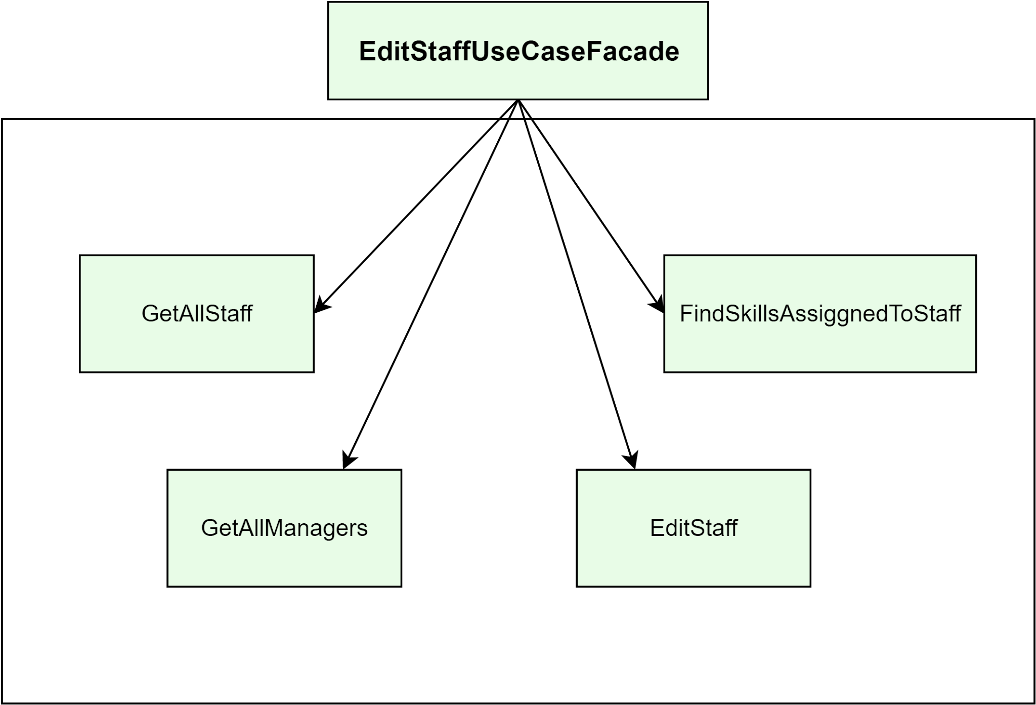
Facade
Our client (controller) only interact with the façade and not the use cases directly
Our façade manages the components required for the controller to work.
We can add additional components to our façade without affecting our wider code
Additional Facades could be created within the façade to form layers if our façade gets too complex
Notes:
The Facade design pattern is a structural pattern in object-oriented programming (OOP) that provides a simplified interface or a higher-level interface to a complex subsystem or set of classes. It aims to hide the complexities of the underlying system and provide a convenient way for clients to interact with it.

Slide 18
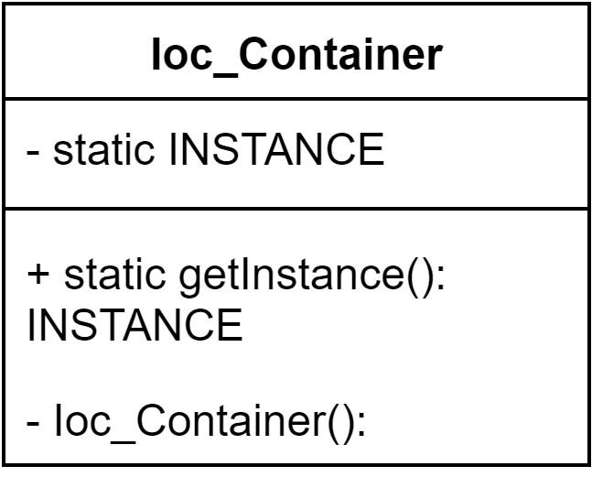
Singleton + Builder
As our code requires values passing to a constructer, we can use a builder pattern to build our Ioc_container before creating its single instance
Eager Initialisation
INSTANCE returns a new Ioc_Container and holds our one instance of the Ioc_Container
Constructor is created private and empty so the class is instantized using getInstance()
getInstance() is a static method which allows us to instantiate our Ioc_Container but also only allows us to return that instance of it
Notes:
Singleton works by creating one instance and then when getInstance is called on the singleton it returns that one instance stopping another instance being created.

Slide 20
Critical Evaluation

Slide 21

OO Concepts
No page numbers available for online texts
Concept | Definition | Reference | Example
Abstraction | Abstraction simplifies complex systems by focusing on essential features and hiding unnecessary details, allowing for clear and concise representations while hiding implementation complexities. | “We can thus abstract out attributes and behaviors for common classes. For example, dogs and cats are both mammals..”(Weisfeld, 2019) | Our factory method abstracts the creation our into our factory and usecaseCommand, requiring the actual implementation of the use cases to remain hidden
Encapsulation | Encapsulation combines data and method into a class, where the data is protected and can only be accessed and modified through defined methods. It ensures the internal state of a object is not accessible from outside | “Encapsulation is defined by the fact that objects contain both the attributes and behaviors. Data hiding is a major part of encapsulation.” (Weisfeld, 2019) | We use a builder method to encapsulate the creation of Ioc_Container singleton. Our use of iteration of our skills is also encapsulating our skill information
Inheritance | Inheritance allows classes to inherit properties and behaviours from other classes in a hierarchical structure. | “Inheritance enables a class to inherit the attributes and methods of another class. This provides the ability to create new classes by abstracting out common attributes and behaviors from another class.” (Weisfeld, 2019) | Manager and StaffUser both inherit from the Abstract User Class
Polymorphism | Polymorphism allows objects of different classes to be treated as objects of a common superclass. It can allow for a single interface to represent multiple related classes. | “Polymorphism means that similar objects can respond to the same message in different ways .” Weisfeld, 2019) | We use polymorphism in our iterator class as it will iterate over any collection as long as it can support a iterator

Slide 22
SOLID
Principle | Definition | Reference | Example
Single Responsibility (SRP) | The Single Responsibility Principle states that a class should only have one purpose or reason to be changed. It results in code that is easier to understand, modify, and maintain. | “A module should be responsible to one, and only one, actor.” (Martin, 2017) | Validator, models, use cases, repositories
Open Closed (OCP) | The Open-Closed Principle suggests that code should be designed in a way that allows adding new functionalities without modifying existing code. | “The Open/Close Principle states that you should be able to extend a class’s behavior, without modifying it.” (Weisfeld, 2019) | Using the user abstract class, we can extend it for multiple user types without having to modify User. It is also evident in the Validator, as we can continue to add classes to be validated without modifying the Validator strategy
Liskov Substitution (LSP) | The Liskov Substitution Principle states that objects of a superclass should be replaceable with objects of its subclasses without affecting the correctness of the program. | “The Liskov Substitution Principle states that the design must provide the ability to replace any instance of a parent class with an instance of one of its child classes. If a parent class can do something, a child class must also be able to do it.” (WeisFeld, 2019) | User is extended by Staff and Manager
Interface Segregation | The Interface Segregation Principle suggests that clients should only depend on the interfaces they actually use. It encourages creating smaller and more focused interfaces to avoid unnecessary dependencies and promote loose coupling. | “The Interface Segregation Principle states that it is better to have many small interfaces than a few larger ones.” (WeisFeld, 2019) | Smaller interfaces used across a range of classes, including but not limited to validation, controllers
Dependency Inversion | The Dependency Inversion principle suggests that clients should couple to abstract rather then concrete implementations. | “The goal of dependency inversion is to couple to something abstract rather than concrete.” (Weisfeld, 2019) | Astractions used for memory database and repositiories

Slide 23
GRASP
Principle | Definition | Reference | Example
Information Expert | Assign a responsibility to the class that possesses the most relevant information and expertise required to fulfill that responsibility. | " Assign a responsibility to the information expert—the class that has the information necessary to fulfill the responsibility.” (Larman, 2004) | Decidated router, use case knowledge is held within the controller, knowledge of repository is held by use case, validators know about models.
Low Coupling | Minimize the dependencies between classes to promote flexibility, reusability, and maintainability. | “Assign responsibilities so that (unnecessary) coupling remains low. Use this principle to evaluate alternatives.” (Larman, 2004) | Repositories use cases use interfaces
High Cohesion | Group together the responsibilities that are closely related to form cohesive classes, ensuring they have a single and well-defined purpose. | “Assign responsibilities so that cohesion remains high. Use this to evaluate alternatives.” (Larman, 2004) | Use case classes are responsible for the creation of models such as skills
Creator | Assign the responsibility of creating objects to classes that have the necessary information and expertise to do so. | “Assign class B the responsibility to create an instance of class A if one of these is true: 1. B contains A 4. B records A 2. B aggregates A 5. B closely uses A 3. B has the initializing data for A” (Larman, 2004) | Use cases such as AddNewSkill
Indirection | Introduce an intermediate object or interface to decouple and mediate between two classes to reduce direct dependencies. | “Assign the responsibility to an intermediate object to mediate between other components or services, so that they are not directly coupled.” (Larman, 2004) | Using interfaces when interacting with the repositories in the use cases

Slide 24
Grasp cont.
Principle | Definition | Reference | Example
Polymorphism | Utilize polymorphism to enable objects of different classes to be used interchangeably by clients through a common interface. | “When related alternatives or behaviors vary by type (class), assign responsibility for the behavior—using polymorphic operations—to the types for which the behavior varies.” (Larman, 2004) | BaseModuleRepository interface
Pure Fabrication | Create classes that don't represent real-world concepts but provide necessary functionality to improve overall system design. | “Assign a highly cohesive set of responsibilities to an artificial or convenience “behavior” class that does not represent a problem domain concept—something made up, in order to support high cohesion, low coupling, and reuse.” (Larman, 2004) | Use cases, repositories, IOC_Controller
Protected Variations | Identify and encapsulate the parts of the system that are most likely to change, allowing for future modifications with minimal impact. | “Identify points of predicted variation or instability; assign responsibilities to create a stable “interface” around them.” (Larman, 2004) | Use cases and repositories
Controller | Assign the responsibility of coordinating and controlling the flow of operations to a class that manages the overall system behavior. | “Assign the responsibility to an object representing one of these choices: Represents the overall “system,” a “root object,” a device that the software is running within, or a major subsystem (these are all variations of a facade controller). Represents a use case scenario within which the system operation occurs (a use-case or session controller)” (Larman, 2004) | FXML allows controllers to handle UI events

Slide 25
KSBs
KSB | Description
SE2 | Undertake analysis and design to create artefacts, such as use cases to produce robust software designs
SE9 | How to operate all stages of the software development lifecycle
SE11 | How to apply software analysis and design approaches
Notes:
SE2 – the entire projects, A1, designing the project, analysing needs, and creating usecases
SE9 –
Requirements & Analysis.
Project Planning.
Design.
Coding & Implementation.
Testing.
Deployment.
Maintenance.
SE11 – During the refactor we analysed our existing solution and reconsidered how we could improve our code by implementing design patterns.

Slide 26
References
Gamma, E., Helm, R., Johnson, R., and Vlissides, J. (1994) Design Patterns: Elements of Reusable Object-Oriented Software. Massachusetts: Addison-Wesley Professional.
Freeman, E., and Robson, E. (2020) Head First Design Patterns. 2nd ed. Sebastopol: O’Reilly Media, Inc.
Kerievsky, J. (2004) Refactoring to Patterns. Boston: Addison-Wesley Professional.
Larman, C. (2004) Applying UML and patterns: an introduction to object-oriented analysis and design and iterative development. 3rd ed. USA:Pearson
Weisfeld, M. (2019) Object-Oriented Thought Process. 5th ed. Addison-Wesley Professional
Martin, R. C., (2017). Clean Architecture: A Craftsman's Guide to Software Structure and Design. Pearson

